Slide 1
REAL TIME AI VIRTUAL MOUSE USING COMPUTER VISION
BY
Harshan R S -910619104027
Adithya S S -910619104004
Ajay M -910619104005
Arvind P -910619104008

Slide 2
ABSTRACT
Currently, wireless mouse or a Bluetooth mouse is not free of devices completely.
It uses a battery for power and a dongle to connect it to the PC.
This limitation can be overcome by employing webcam or a built-in camera.
Capturing of hand gestures and hand tip detection using computer vision.
To avoid COVID-19 spread by eliminating the human dependency of devices to control the computer.

Slide 3
INTRODUCTION
The mouse is one of the wonderful inventions of Human-Computer Interaction (HCI) technology.
These devices are becoming compact in the form of Bluetooth or wireless technologies.
Use of hand gestures and hand tip detection for performing mouse functions in the computer.
To perform computer mouse cursor functions using a web camera or a built-in camera in the computer.

Slide 4
EXISTING SYSTEM
The existing system is being implemented by using a wireless or a Bluetooth mouse.
These devices use dongle to connect to the PC, and also, a battery to power the mouse to operate.
Amidst of the COVID-19 situation, it is not safe to use the devices by touching them.
It may result in a possible situation of spread of the virus.

Slide 5
PROPOSED SYSTEM
To develop an alternative to the regular and traditional mouse system to perform and control the mouse functions.
This can be achieved with the help of a web camera that captures the hand gestures and hand tip.
Then processes these frames to perform the particular mouse function such as left click, right click, and scrolling function.

Slide 6
REQUIREMENTS
HARDWARE REQUIREMENTS:
Web camera / Built-in Camera.
SOFTWARE REQUIREMENTS:
PyCharm (Environment to run python code).
Python 3.9 (This Version supports the required packages).
Required Python packages.

Slide 7
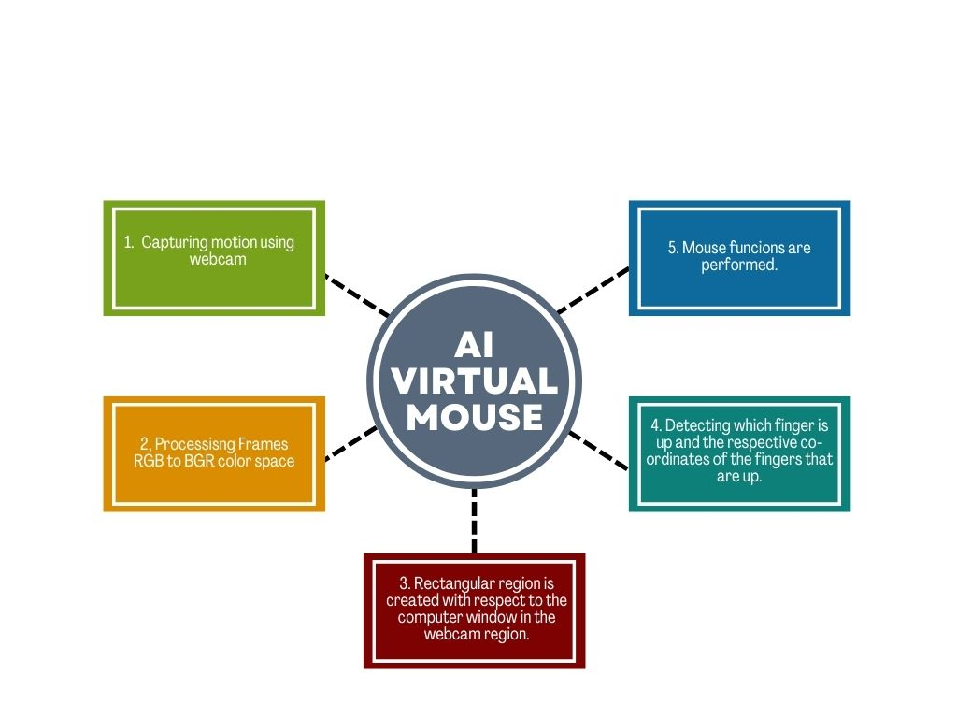
FLOW DIAGRAM

Slide 8
MODULES
Webcam Functioning.
Capturing and Processing.
Rectangular Region for Moving through the Window.
Detection and Performance

Slide 9
Webcam Functioning
It is based on the frames that have been captured by the webcam in a laptop or PC.
By using OpenCV, the video capture object is created and the web camera will start capturing video.
The web camera captures and passes the frames to the AI virtual system.

Slide 10
Capturing And Processing
Uses the webcam where each frame is captured till the termination of the program.
The video frames are processed from BGR to RGB color space to find the hands in the video frame by frame.

Slide 11
Creation of Rectangular Region
Makes use of the transformational algorithm.
It converts the co-ordinates for controlling the mouse.
When hands are detected, a rectangular box is drawn with respect to the computer window in the webcam region.
We move throughout the window using the mouse cursor.

Slide 12
Detection and Performance
We are detecting which finger is up and the respective co-ordinates of the fingers that are up.
According to that, the particular mouse function is performed.

Slide 13
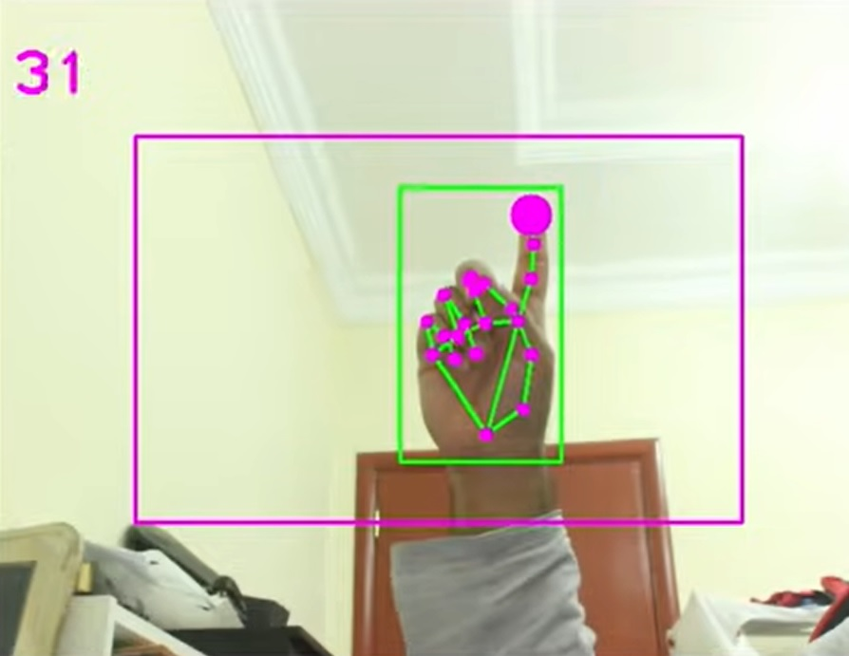
SCREENSHOT

Slide 15
CONCLUSION
To control the mouse cursor functions by using the hand gestures instead of using a physical mouse.
It has a greater accuracy compared to the existing models.
The model overcomes most of the limitations of the existing systems.
It can be used to reduce the spread of COVID-19.
This system could be useful in presentations and to reduce work space.

Slide 16
REFERENCES
D. L. Quam, “Gesture recognition with a DataGlove,” IEEE Conference on Aerospace and Electronics, vol. 2, pp. 755–760, 1990.
L. Thomas, “Virtual mouse using hand gesture,” International Research Journal of Engineering and Technology (IRJET, vol. 5, no. 4, 2018).
It Provided information about the flow of Operation of the system .
It provided clear knowledge about the working of the system.

Slide 17
THANK YOU

